Slide 1
Instructions for Submitting Assigments to Turnitin.com

Slide 2
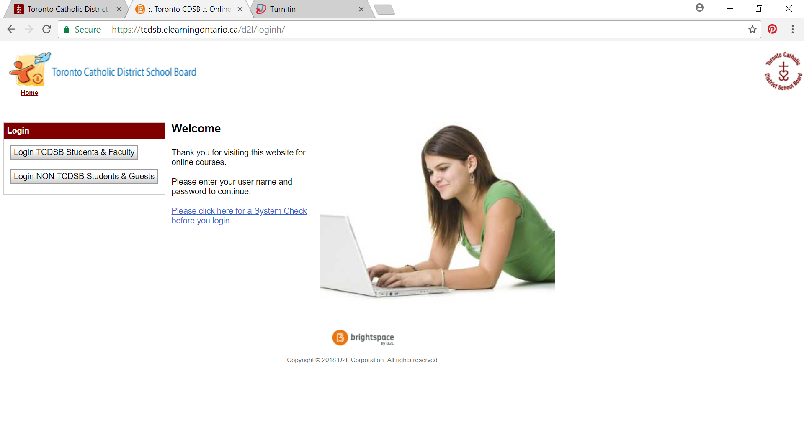
Go to http://tcdsb.elearningontario.ca

Slide 3
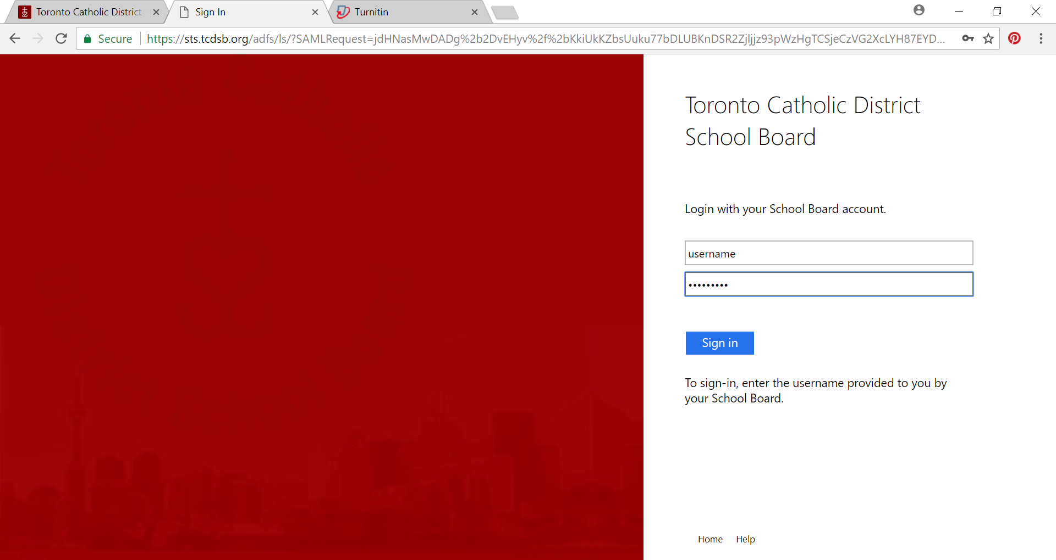
Use your TCDSB school login and password

Slide 4
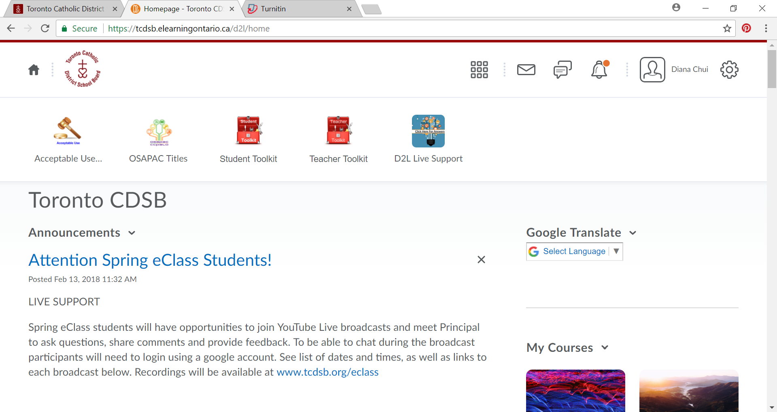
Scroll down

Slide 5
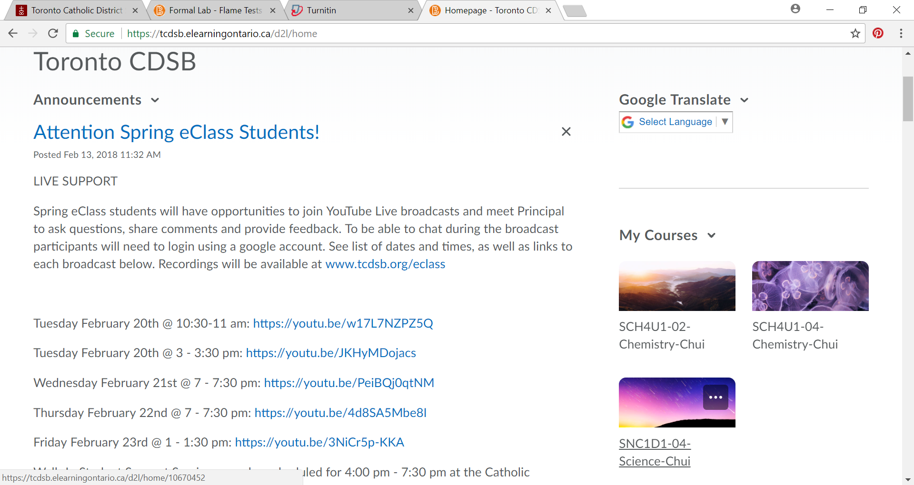
Look for your course

Slide 6
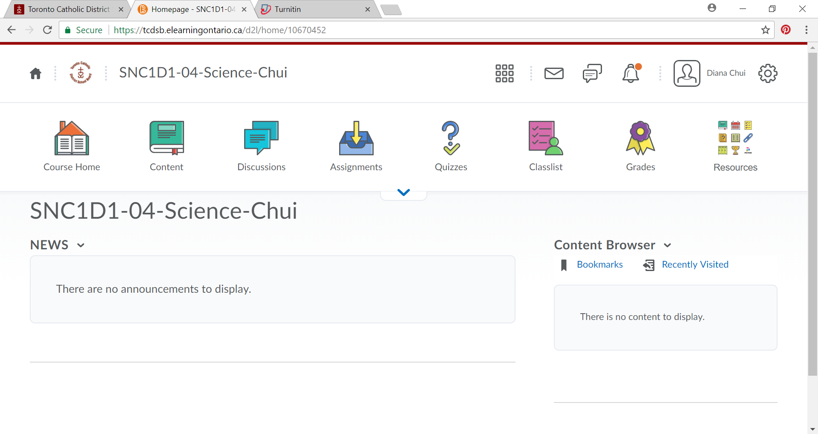

Slide 7
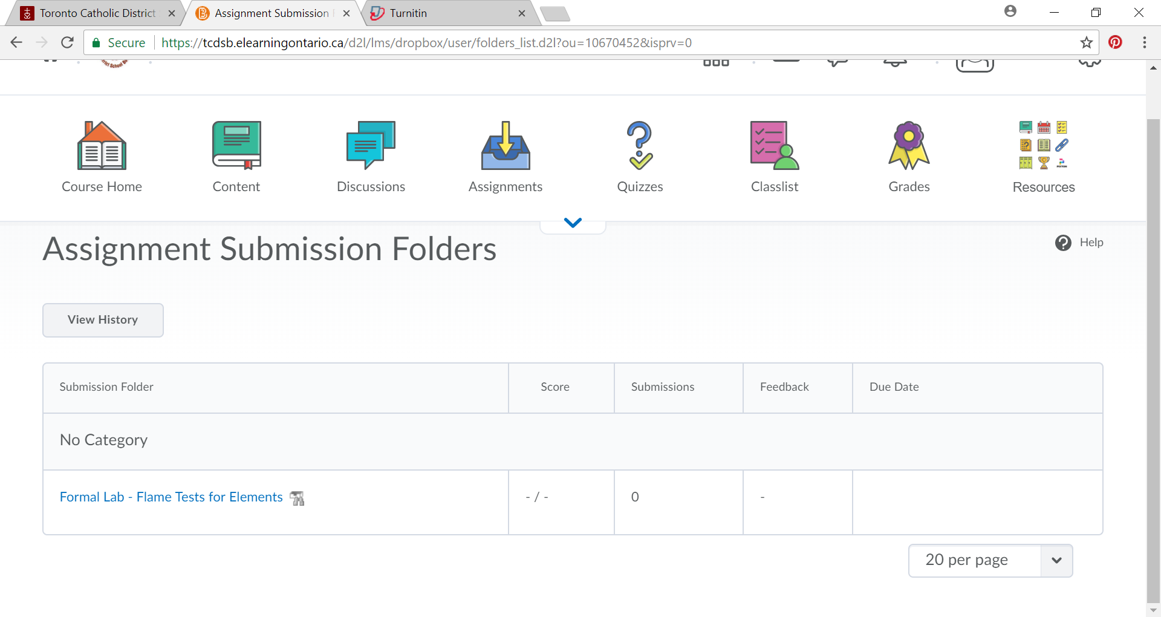
Find the assignment name

Slide 8
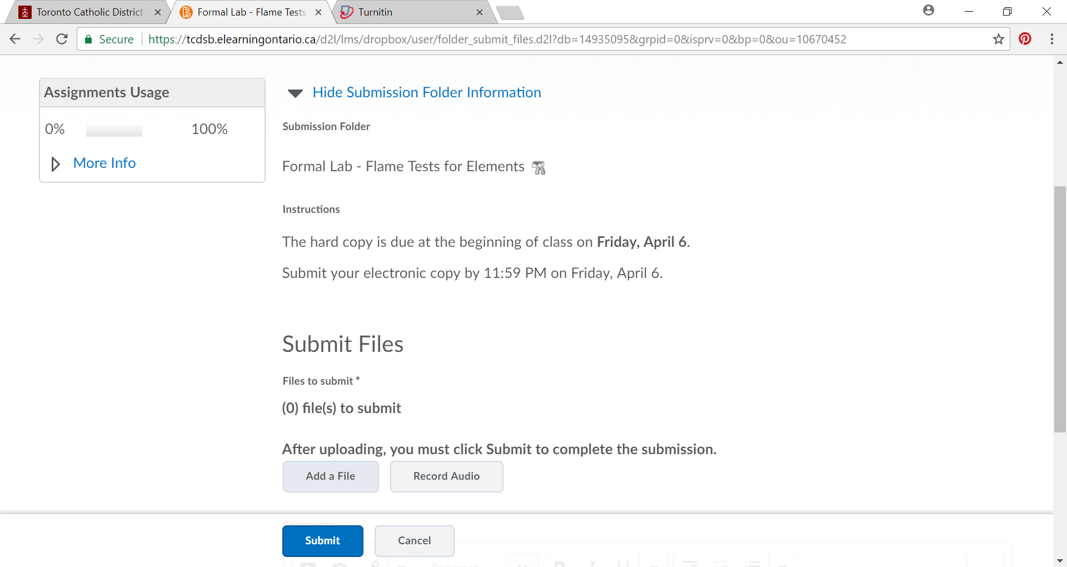

Slide 9
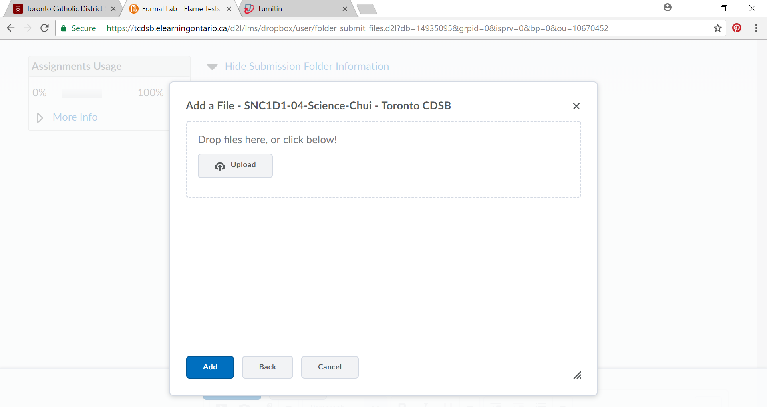
Find the file on your computer.
Click “add”, then “submit”.

